Slide 1
Intake/Interview & Quality Review Sheet
IRS Form 13614-C

Slide 2
IRS Intake/Interview Sheet – Form 13614-C
Must be completed for every tax return we prepare
Required starting point for taxpayer(s) is to complete Form 13614-C
The Intake/Interview sheet is the basis for the taxpayer interview
The Intake/Interview Sheet is to be corrected as required from taxpayer documents and the interview
Taxpayer fills out most, but volunteers may assist

Slide 3
Intake/Interview & Quality Review Sheet (13614-C) - Page 1
General information about taxpayer, spouse and dependents.
Completed by taxpayer except for Part II shaded area
Information on this page entered on “Main Information Sheet” in TaxWise by preparer
Part I - Taxpayer personal information
Part II - Marital Status & Household information
Part II shaded area – to be completed by preparer
Notes:
Post a copy of the Intake Form on the web site so that students can print it or look at it full screen.

Slide 4
Intake Sheet Page 1 Personal Information Part I

Slide 5
Intake Sheet Page 1 Marital & Household Information – Part II

Slide 6
Intake/Interview & Quality Review Sheet (13614-C) - Page 2
Part III – Income questions
Part IV – Expense questions
Part V – Life events questions
Answers to all the questions must agree with documents presented by taxpayer
Preparer to make corrections and initial where changes are made

Slide 7
Intake Sheet Page 2 Income – Part III

Slide 8
Intake Sheet Page 2 Expenses – Part IV

Slide 9
Intake Sheet Page 2 Life Events – Part V

Slide 10
Intake/Interview & Quality Review Sheet (13614-C) Page 3
Part VI – Health Care Coverage
Questions 1 & 2 – Completed by Taxpayer
Shaded Area – Completed by preparer by interviewing taxpayer
This section is not included in the 2019 Intake/Interview Sheet
Part VII Additional Information & Questions
1. Taxpayer email address (not required)
2. Presidential Election Campaign Fund question
3. Tax refund questions
4. Balance due questions
5. Grant Money Questions
6. Additional comments

Slide 11
Intake Sheet Page 3 – Health Care Coverage - Part VI
Not part of the 2019 Form

Slide 12
Intake Sheet Page 3 – Additional Information & Questions – Part VII

Slide 13
Intake/Interview & Quality Review Sheet (13614-C) Page 4
Consent Form
Consent form for Disclosure of Tax Return Information to VITA/TCE Tax Preparation Sites
For Familiarization Classes we will select consent
For TY 2019 AARP will provide an Intake/Interview book that will contain the 2019 Intake/Interview form, additional consent forms, and additional grant questions.

Slide 14
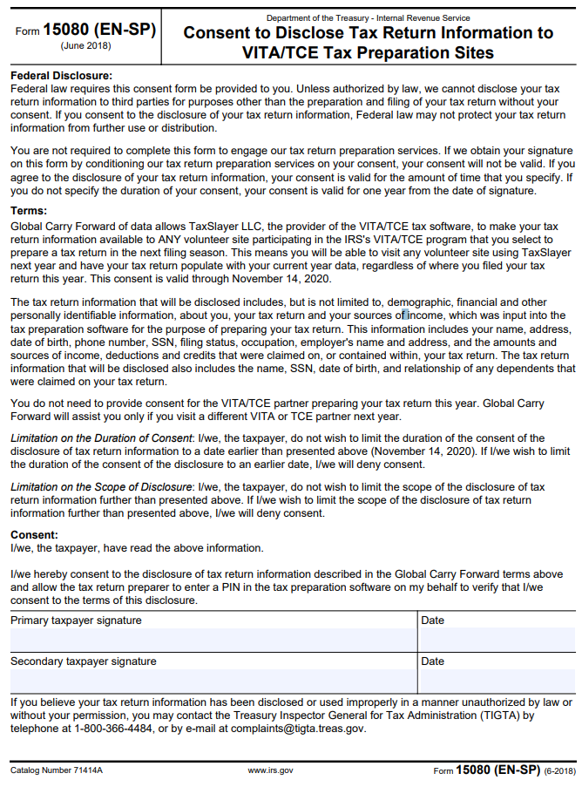
Intake Sheet Page 4

Slide 15
Summary
The Intake/ Interview & Quality Review Sheet is required for every tax return we prepare
The Intake Sheet is completed by the taxpayer and reviewed and corrected by the preparer prior to entering any information into TaxWise Software.
The Intake Sheet is kept by the taxpayer

